Slide 1
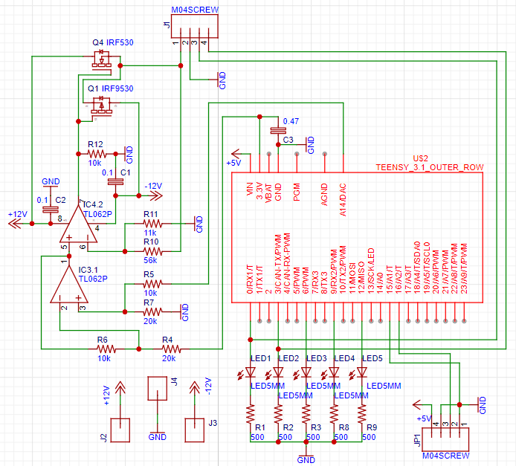
Chaotic Oscillators
By: Bodhi Broderick and Nicholas Proctor

Slide 2
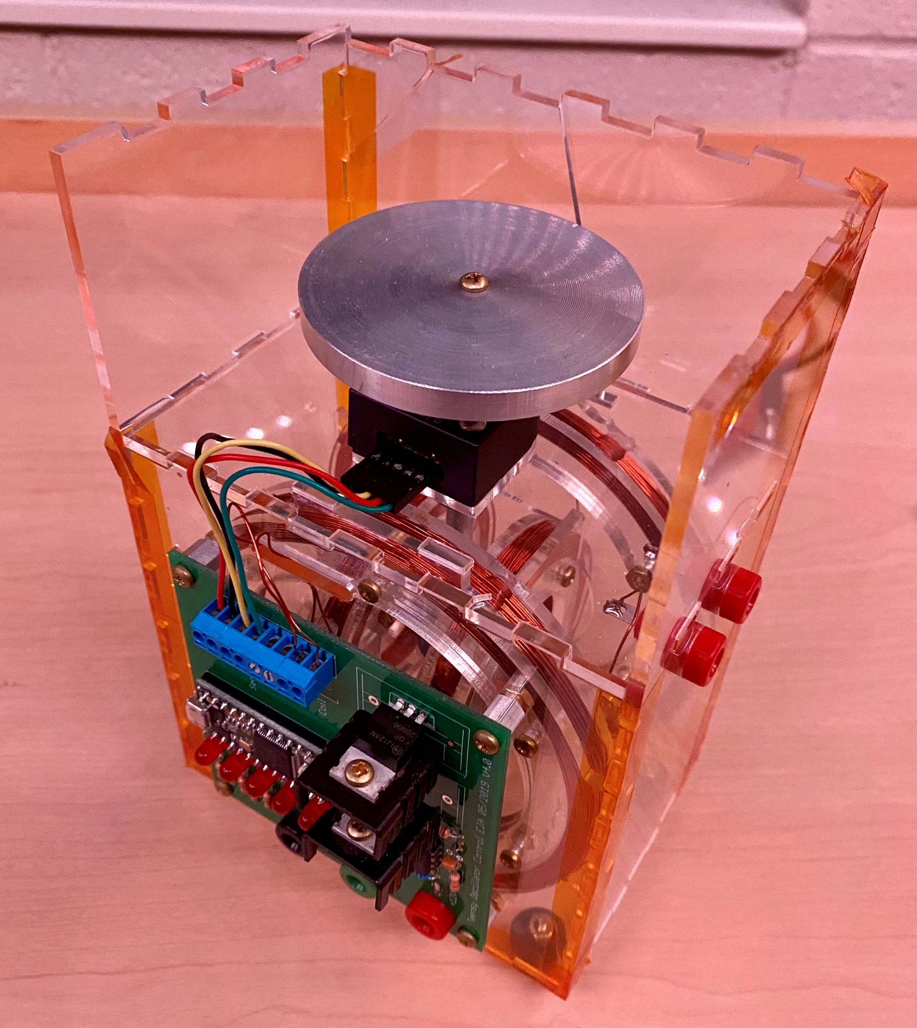
Chaos Theory
Predictable Deterministic Systems that are:
Sensitive to initial conditions
Topologically transitive
Shifts between >1 end conditions
w/ dense periodic orbits
Mechanical Chaotic Oscillator
2 sets of coils => 2 Magnetic Fields
Large orients central magnet
Small toggled to create chaotic oscillation

Slide 3
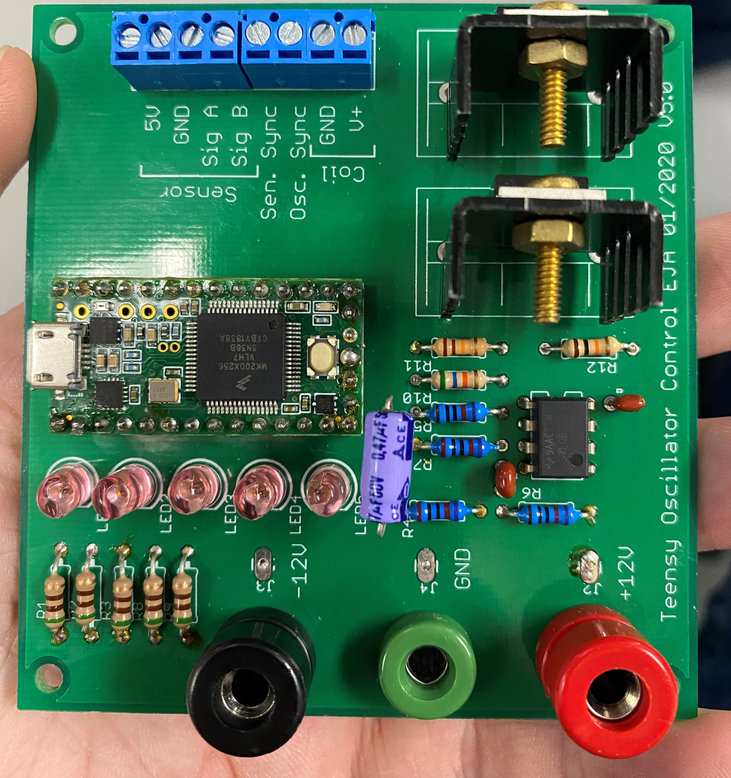
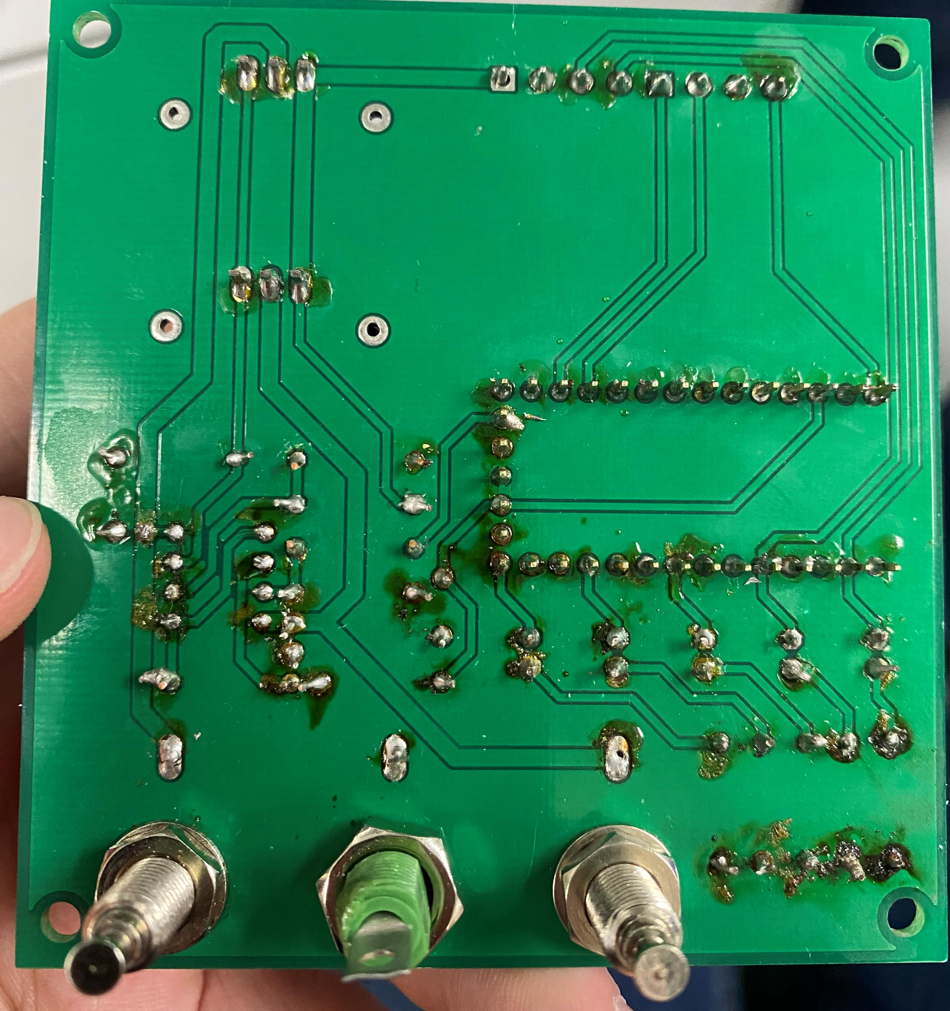
Circuit Analysis
Identified Critical Points
Microchip / Op-Amp orientation
Not having differing transistors
Direction of capacitors
Resistances
Received the schematics
Re-ordered to better match the PCB
Made new circuit board
Observing oscillation but only at .05A

